Slide 1
Lecture 7. New Product Introduction. Innovation. Industry Life cycle
Competitive Strategy
Luis Garicano

Slide 2
Great Ideas = Pots of Money ?
Edison & Electricity
Coke and Diet Coke
Prozac
Apple iPhone iPad
IBM PC
Xerox PARC
TV

Slide 3
Outine
I. Does the innovation create value?
Forecasting size and composition of demand
II. The challenge for innovator
1. Short run capture
2. Long run advantage
III. The challenge for the incumbent: reorienting strategy

Slide 4
I. Is the innovation valuable? The problem of Forecasting Demand

Slide 5
Does the innovation create value?
If innovation really adds value, it should be straightforward to identify the value that is created.
CT scanner example illustrates the difficulty of forecasting demand even when tremendous value is created.
Can be hurt also by competitors’ failures to forecast demand (assuming no coordination).

Slide 6
CT Scanner Shipments

Slide 7
CT Scanner Shipments (EMI versus others)

Slide 8
Units Ordered, U.S. Community Hospitals 100+ Beds
Source: Trajtenberg, 1990, p. 92-101

Slide 9
Number of CT Scanner Suppliers
Source: Trajtenberg, 1990, p. 92-101

Slide 10
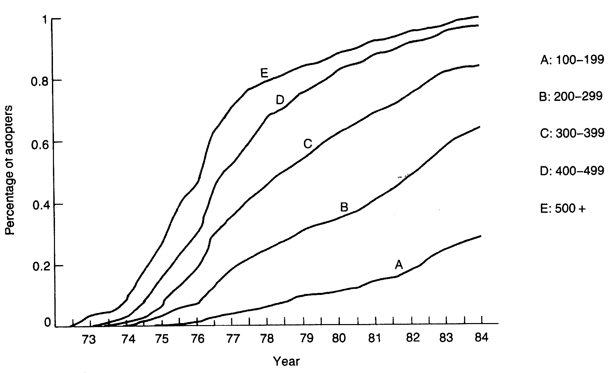
Diffusion of CT Scanners by Hospital Size
Source: Trajtenberg, 1990, p. 59

Slide 11
EMI & the CT Scanner
U.S. demand dropped dramatically. Saturation level of 6/million people nearly reached by 1981
Major price competition with 12 competitors at the peak — rapid shakeout thereafter
Hounsfield receives Nobel Prize in 1979
EMI taken over by Thorn Electric in response to cash crisis
GE buys Medical Division

Slide 12
Key Issue
Forecasting the path of technological change
Will the new technology take off? How fast? Will it substitute for existing or be complementary with it?

Slide 13
A Key Forecasting Framework: The industry life cycle
Era of Ferment/
Discontinuity
Maturity
“Dominant design”
emerges
Incremental
Innovation
Source: Rebecca Henderson
Notes:
14
Examples – Car- metal chassis, gasoline, 4 wheels; PC- mouse GUI, hard drive
what is important about the transition to new designs is the discontinuity

Slide 14
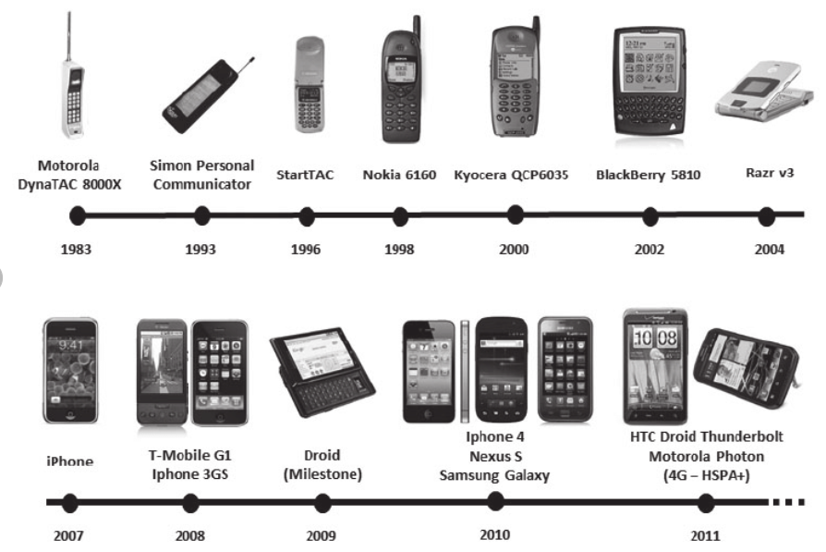
Example 1: Smartphone PLatform

Slide 15
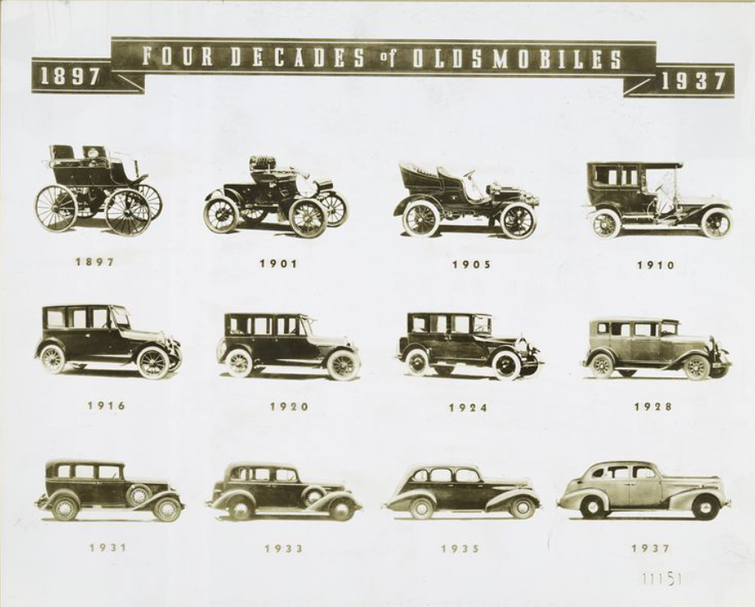

Slide 16
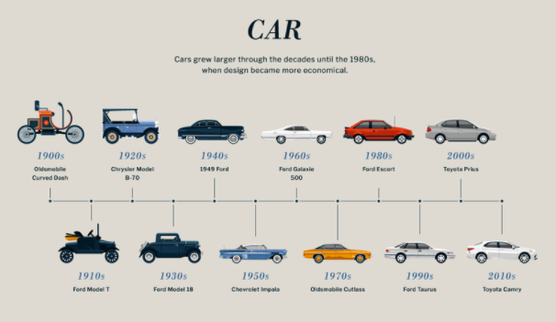
Car `

Slide 17
Industry Life Cycle as an S curve
Performance
Maturity
Discontinuity
Takeoff
Ferment
Time
Notes:
17
6

Slide 18
Christensen: Staying Close to Your Customers May Be a Problem
Established technology
Performance
Mainstream customer needs
Invasive Technology
Niche customer needs
Time
Notes:
34
In forecasting future evolution of technology we are told to stay close to the customers. and indeed that is a problem in kodak. and yet, staying close can be a problem. this is Christiansen’s point
Example with the IBM /DEC etc. Mini-systems IBM 360 etc.

Slide 19
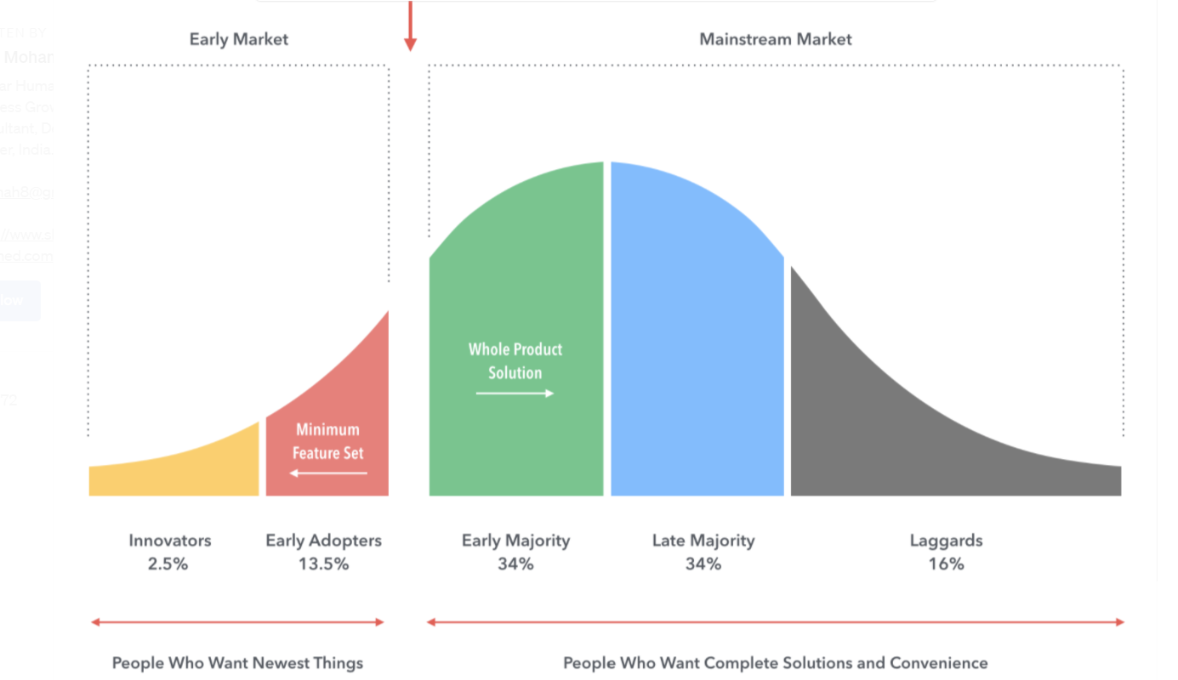

The chasm (Geoffrey Moore) (1991, 2014)
Huge gap between early adopters and “majority”
Crossing the chasm
“Enthusiasts”: want something new, want to play with it
“Pragmatists”: want something that works

Slide 20
Managerial Implications
Diffusion Paths
Are very difficult to predict
The “Chasm” is no legend!
Pioneer innovators face difficulties riding the diffusion curve
Commercializing in-house is difficult
Firm faces greatest competition precisely when adoption ‘takes-off’
Sustaining leadership requires development of systems that entrants find difficult to copy

Slide 21
II. The innovator’s problem: how to capture value from a valuable innovation in the short run and long run

Slide 22
Capturing Value From an Innovation
Short run appropriation
Converting innovation into long run advantage

Slide 23
A. Short run capture
Two obstacles
Difficulty of trading (selling, licensing), and hence, appropriating, IP.
Need for complementary capabilities or positional resources (rents go to those who have them).

Slide 24
Difficulty of Trading IP vs. Physical Assets
Characteristics | Know-how/IP | Physical Commodities
Disclosure of Attributes | Relatively difficult | Relatively easy
Property Rights | Limited | Broad
Item of Sale | License | Measurable unit
Variety | Heterogeneous | Homogeneous
Unit of Consumption | Often unclear | Weight, volume, etc.
Inherent tradability | Low | High
Implication: As EMI illustrates, it may be difficult to capture the value from licensing the idea.

Slide 25
Potential Sources of Appropriability
Intellectual property protection
Patents
Finite length
The right to prohibit “producing”
Copyrights
The right to prohibit “copying”
Secrecy
Trade secrets & non-compete clauses
Complexity and “tacit” knowledge
Speed

Slide 26
Intellectual Property Protection
Strengths
Legal right
Can be traded
Buys time to build complementary assets
Provides temporary monopoly
Slows competitors down
Weaknesses
Disclosure requirements
Costly to enforce
Can be invented around
Could be too short
Not everything can be patented
False sense of security

Slide 27
Windshield Wipers
1962: Robert Kearns invented a little wiper switch that made the intermittent wiper possible
Fitted car with it and drove it to Ford
Ford passed on innovation
Kearns obtained patents
1969: Ford and others cracked secret
1990: Kearns wins suit against Ford for potential damages payout of $ 325 million (eventually gets $ 8 million).

Slide 28
Secrecy
Strengths
No disclosure
Weaknesses
Difficult to maintain
Non-compete clauses are costly to enforce
Good technical people do not want their work shrouded in secrecy

Slide 29
Speed
Strengths
Competitors cannot catch up
Costly to imitate
Quick profits
Weaknesses
Over soon
Diminishing returns
Difficult to sustain
Difficult to pull off/Treadmill
Dissipates industry profits

Slide 30
The Profits Often Go to the Owners of Complementary Assets
Complementary assets are those necessary to translate an innovation into commercial returns
Positional resources
Brand name
Distribution channels
Customer relationships
Capabilities
Manufacturing capabilities
Sales and service expertise

Slide 31
Complementary Assets and Survival in the Typesetter Industry
Waves of innovation
1440: manual, Gutenberg
1886: ‘hot metal’ linotype machine, Mergenthaler
1949: analog phototypesetting
1965: digital CRT phototypesetting
1976: laser imagesetting
One firm, Mergenthaler Linotype, survived as industry leader

Slide 32
Mergenthaler’s success
1895: recognised need for new font development
1902: library of over 100 fonts
1913: 1000 typefaces
1923: 200 typefaces
Would take 20 years for an entrant to duplicate (with computers, it took Compugraphic a decade and $23 million to generate 1000 fonts)
Key fonts trademarked: “Helvetica”
Complementary assets as a source of market power.

Slide 33
Assess Control of Complementary Assets
Suppose that innovation had been developed by an “external” start-up team
Would the start-up consider you the ideal partner?
Are there any capabilities for which it is necessary to approach a partner? A potential competitor??
Firm controls stage-specific assets if a start-up would consider you the ideal partner and there are no “bottleneck” issues
EMI in Scanners?

Slide 34
B. Long run competitive advantage
In Science, yes: glory goes to the first to make the discovery (Hounsfield)
Yet, not so clear in the race to commercialize innovations.
Second movers may have an advantage
May prefer to harvest value rather than reinvest.
Notes:
Reputation?
On-time delivery is bad.
Customer service appears to be bad, but improving (maybe)
Could they ever provide high quality service as cheaply as GE?
Switching cost? Does the installed base help much here?
Costs for the technicians -- Do the docs (making decision) have incentives to internalize costs?
The installed base probably hurts if the service sucks.
Does EMI have experience curve advantage?
Not obvious--outsourced most, 80% of CGS purchased parts.
Does Emi have technological Advantage going into future?
Has reinvested much of the profits of the division into R&D.
Hounsfield is distant from the market, seems to be unclear whether he knows what the market wants.
Others, like Technicare not investing heavily in R&D-- fast copiers
Key strategic decision: Harvest advantages or invest to turning first-mover position into long-run competitive advantages.
EMI’s service, etc. makes it look like a harvester, except, they keep putting the money back into the business.

Slide 35
Innovator Advantages
Market power until entry
Potential long-run advantages
Reputation, switching costs
Learning curve, patents
Preemption
Tie up inputs, location, distribution channels
Preemptive positioning in marketing or standards
These advantages require investment!!
Often an important tradeoff between maximizing value of pre-entry market power and long-run advantage.

Slide 36
Innovator’s disadvantages
Also some first-mover disadvantages :
Technological competition
Provision of a public good.
Non-proprietary technology/ Patent protection?
Can new technology be leapfrogged
Uncertainty on market size and structure
Entry/Future market structure
Resolving demand uncertainty
Regulatory approval
Notes:
Inability to forecast demand?
Anybody could have made that mistake. This is a fundamental problem with a new product.
Entry faster than expected.
For small guys yes.
The big guys are taking longer than expected.
Took too much time between announcement and bringing product to market, allowing competitors valuable catch-up time.
They did not respond to apparent patent infringements.
They were unresponsive to customer problems and changing needs
Partly because customers and decision-makers so far apart.

Slide 37
III. The incumbent’s problem: How to Reorient Strategy in the Face of Technological Discontinuity

Slide 38
The transition problem
Managing the transition
Leveraging existing capabilities and positional assets to
Create a new market position
Develop new organizational capabilities
Problem:
Capability and positional assets necessary for the new technology may be fundamentally at odds with those that were complementary with the existing
.

Slide 39
The nature of technical work changes
Performance
We need to be
responsive & flexible
but controlled
Will it work?
Exploration, fun,
creativity key
Can we make
100,000?
And service them?
Will it work?
Exploration, fun,
creativity key
Time
Notes:
17
6

Slide 40
The Organizational Challenge Changes Significantly
Performance
“Coordination &
control” critical
“Entrepreneurial
Energy” critical
“Entrepreneurial
Energy” critical
Time
Notes:
17
6

Slide 41
The Marketing Challenge evolves
Performance
Stay close to your
customer – really close
Who
needs this?
Do we have
any reference
customers?
Who
needs this?
Time
Notes:
17
6

Slide 42
The ways in which a firm captures value also evolve dramatically
Performance
We may not be leading edge
but you’d rather buy
from us because…
We can sell it,
make it,
service it, ship it
Most of the time
Speed, IP
Differentiation,
Frontier performance key
Speed, IP
Differentiation,
Frontier performance key
Time
Notes:
17
6

Slide 43
Kodak’s failure
Early days (1983-1993)
Massive R&D investments in digital imaging, despite the absence of a market ($ 5BL)
Many technical achievements
Camera available in early nineties
Product market strategy driven by desire to replicate traditional “razor-blade” model
Despite technological achievements, attention focused on Photo-CD
Fisher’s era (1993-1997)
Radical strategic change: we are an imaging company
Making money on blades as well as razors
Attempted radical intra-organizational change
Refocusing on core; Rationalization of operations; Reorganization; Managerial change
Middle managers resist new strategic orientation

Slide 44
While the company accumulates losses in digital imaging, Fuji attacks core business…
Core business:
Dramatic loss of market share
Worldwide: 1983 1997 2001
Kodak 80% (approx.) 46% 36%
Fuji 8-10% (approx.) 29% 37%
US:
1983 1997 2001
Kodak 90% 60%
Fuji 7-8% 38%
Fuji’s increased penetration, relationships with retailers
A massive failure

Slide 45
Kodak, lessons
The disruption may actually have huge costs on the current business
Kodak’s massive R&D investments in digital imaging despite the absence of a market ($ 5BL) and the likelihood that the traditional business had considerable staying power.
Together with ill-advised diversification, may have dissipated resources and attention from responding to Fuji.

Slide 46
Kodak, lessons
Kodak illustrates the difficulty of trying to change from within…
Difficulty of overcoming entrenched culture and strategy reflected in poor execution of the Photo-CD, fixation on “razor-blade” model.
In general, difficulty of instituting change from within leads to the oft-heard advice to separate new ventures in “greenfield” divisions (e.g., Saturn).

Slide 47
Kodak, lessons
… but change from “without” may be difficult as well.
If digital had been done “far from Rochester,” what would Kodak have been leveraging? And if the goal is to change the core of the organization, doing it with a greenfield operation may hinder this (e.g., Saturn again).
While Fisher scored some major successes (rollback of misguided diversification, China), he encountered difficulty getting buy-in from middle-managers.

Slide 48
Wrap up
Enormous difficulty of forecasting demand
Tools
Innovator: Capturing short run and long run value from innovation (IP, Complementary assets)
The challenge for the incumbent: a different organization is required for innovation

